Slide 1
Course Introduction
Fall 2019
Dr. Shannon Quinn

Slide 2
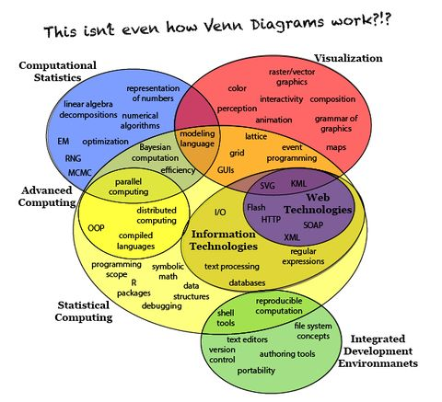
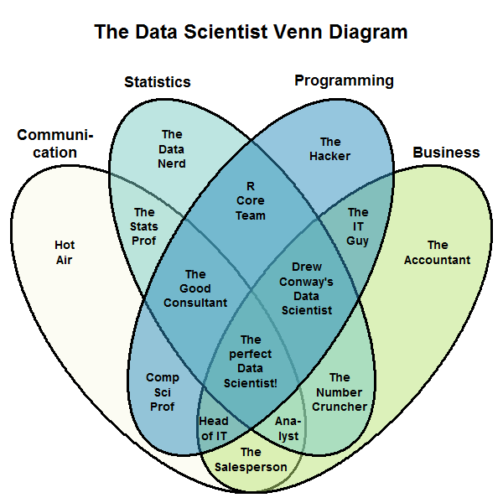
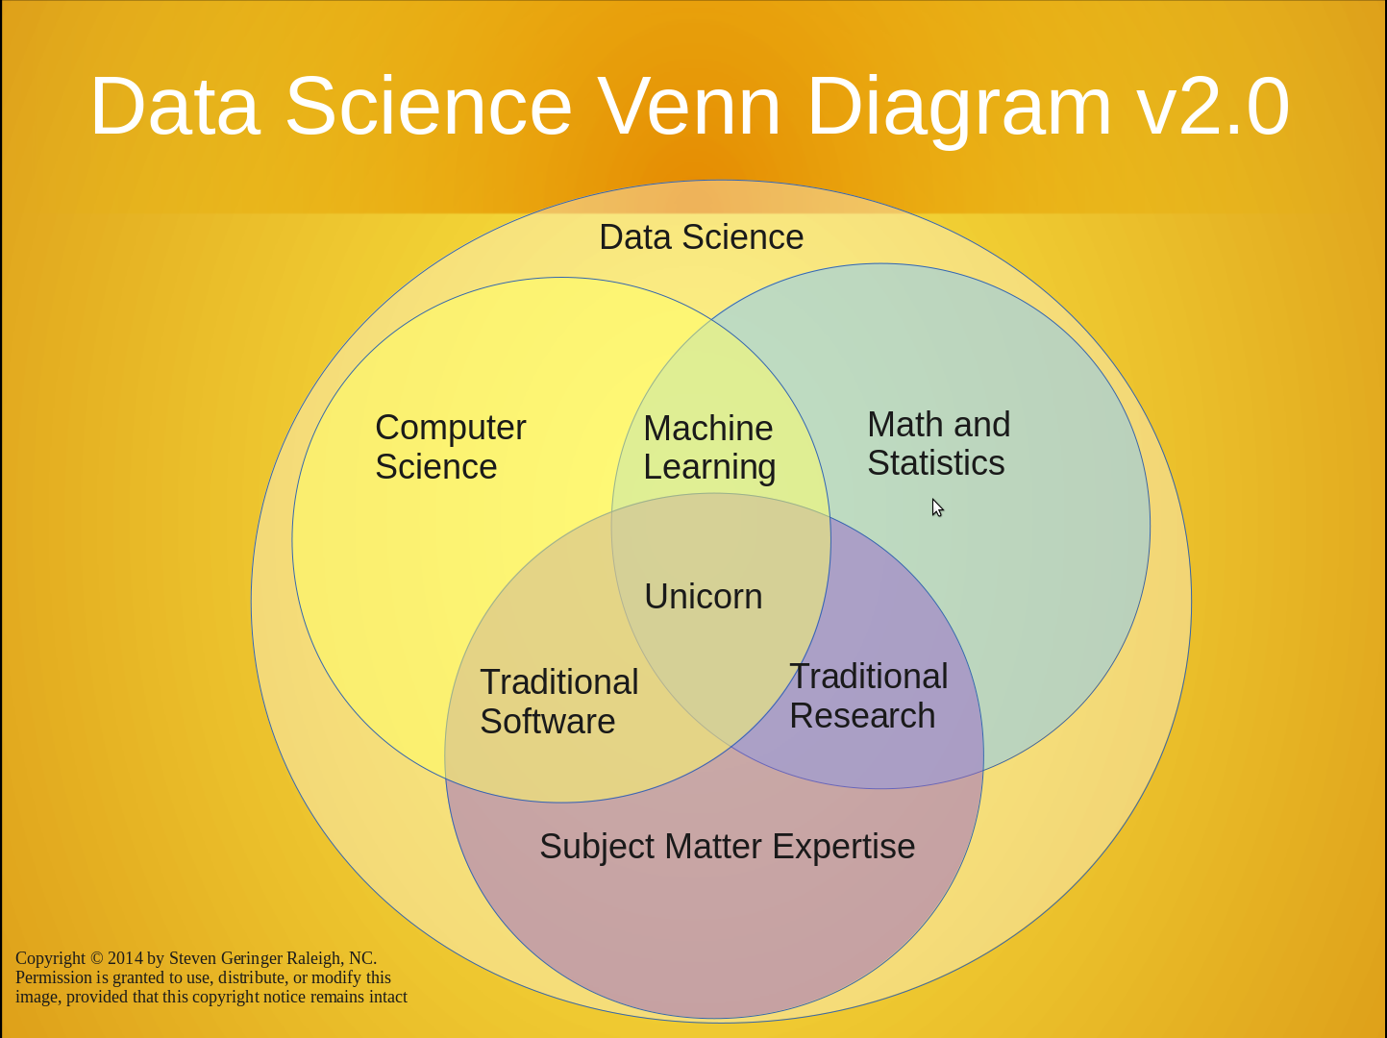

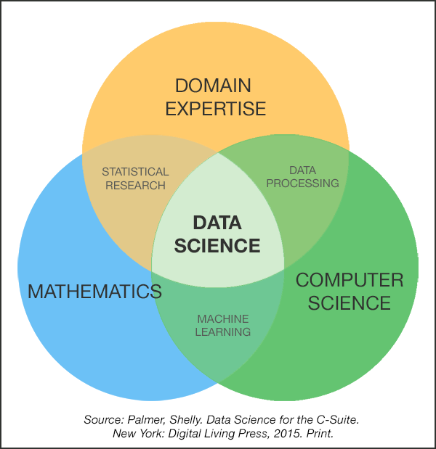
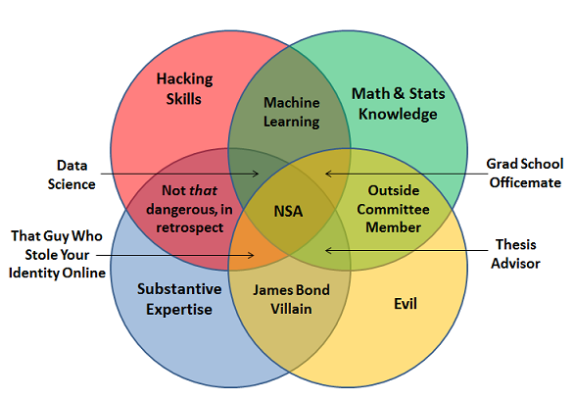
What is “data science”?
It’s a field singularly devoted to bringing back the Venn Diagram

Slide 3
What is “data science”?
From Wikipedia (emphasis mine):
Data science, also known as data-driven science, is an interdisciplinary field about scientific methods, processes, and systems to extract knowledge or insights from data in various forms, either structured or unstructured, similar to data mining. Data science is a "concept to unify statistics, data analysis and their related methods" in order to "understand and analyze actual phenomena" with data. It employs techniques and theories drawn from many fields within the broad areas of mathematics, statistics, information science, and computer science, in particular from the subdomains of machine learning, classification, cluster analysis, data mining, databases, and visualization.

Slide 4
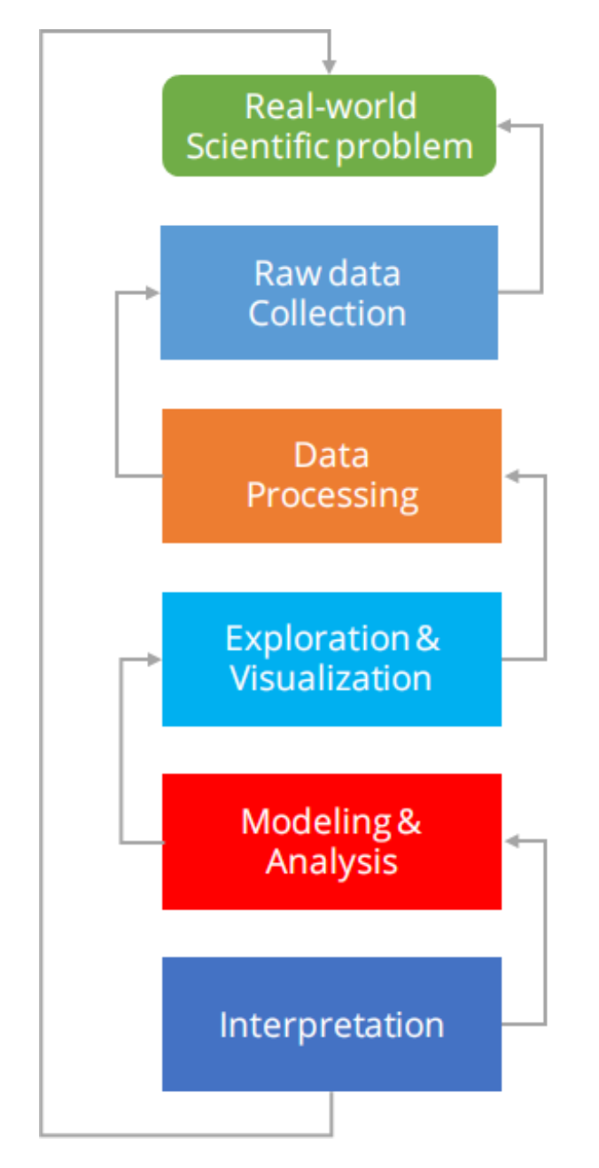
What is “data science”?
If you want my opinion: Dr. Lee nailed it in CSCI 3360
Data Science encompasses the entire problem stack
Problem definition
Data collection & cleaning
Exploration
Modeling
Interpretation & insights

Slide 5
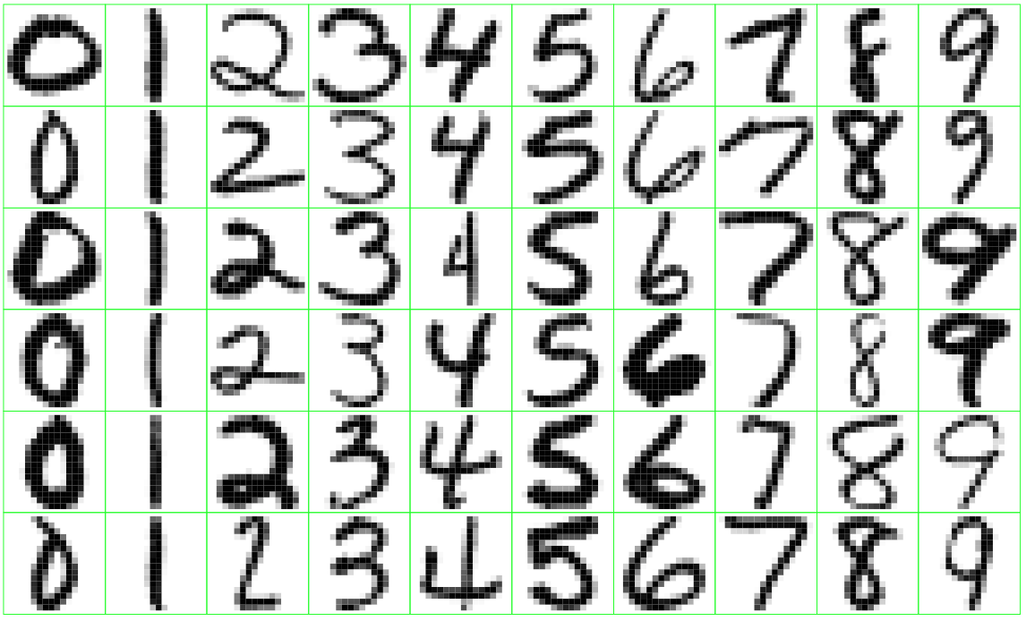
Data Science in practice
Can we automatically sort mail based on ZIP code?

Slide 6
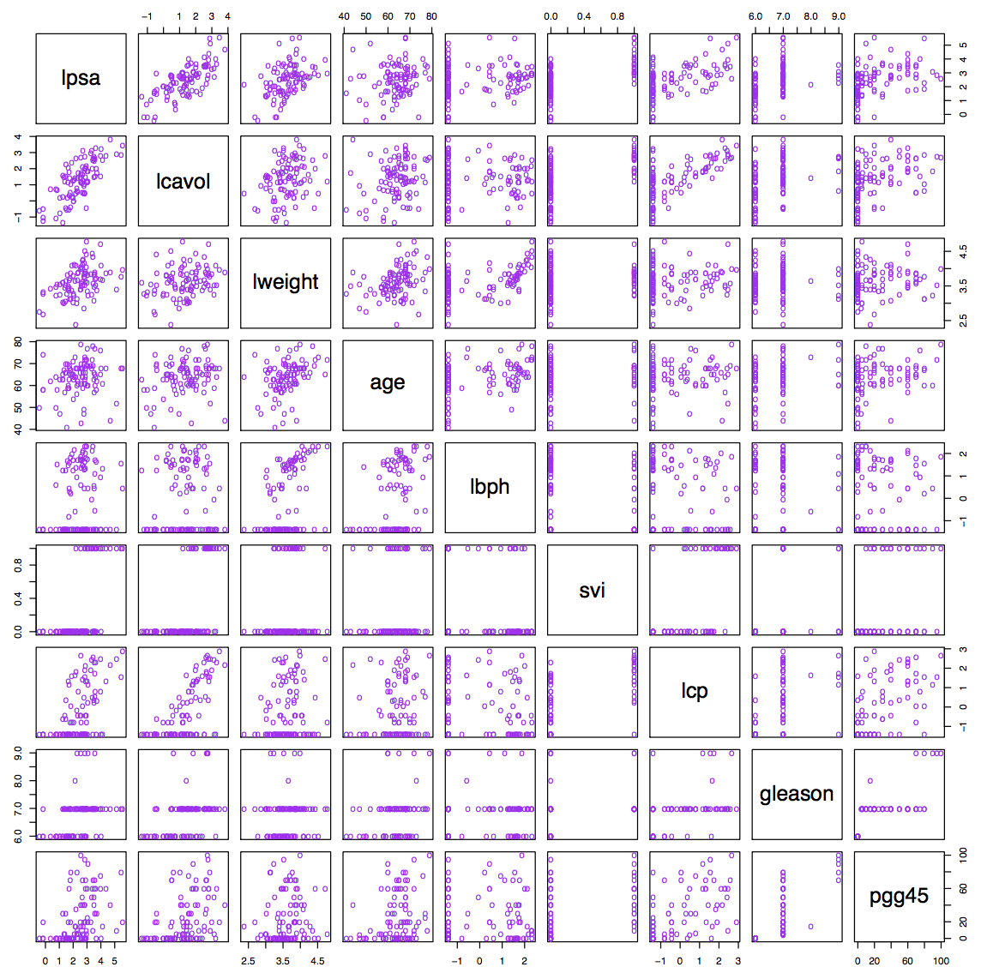
Data Science in practice
What features of prostate cancer are indicative of production of specific antigens?

Slide 7
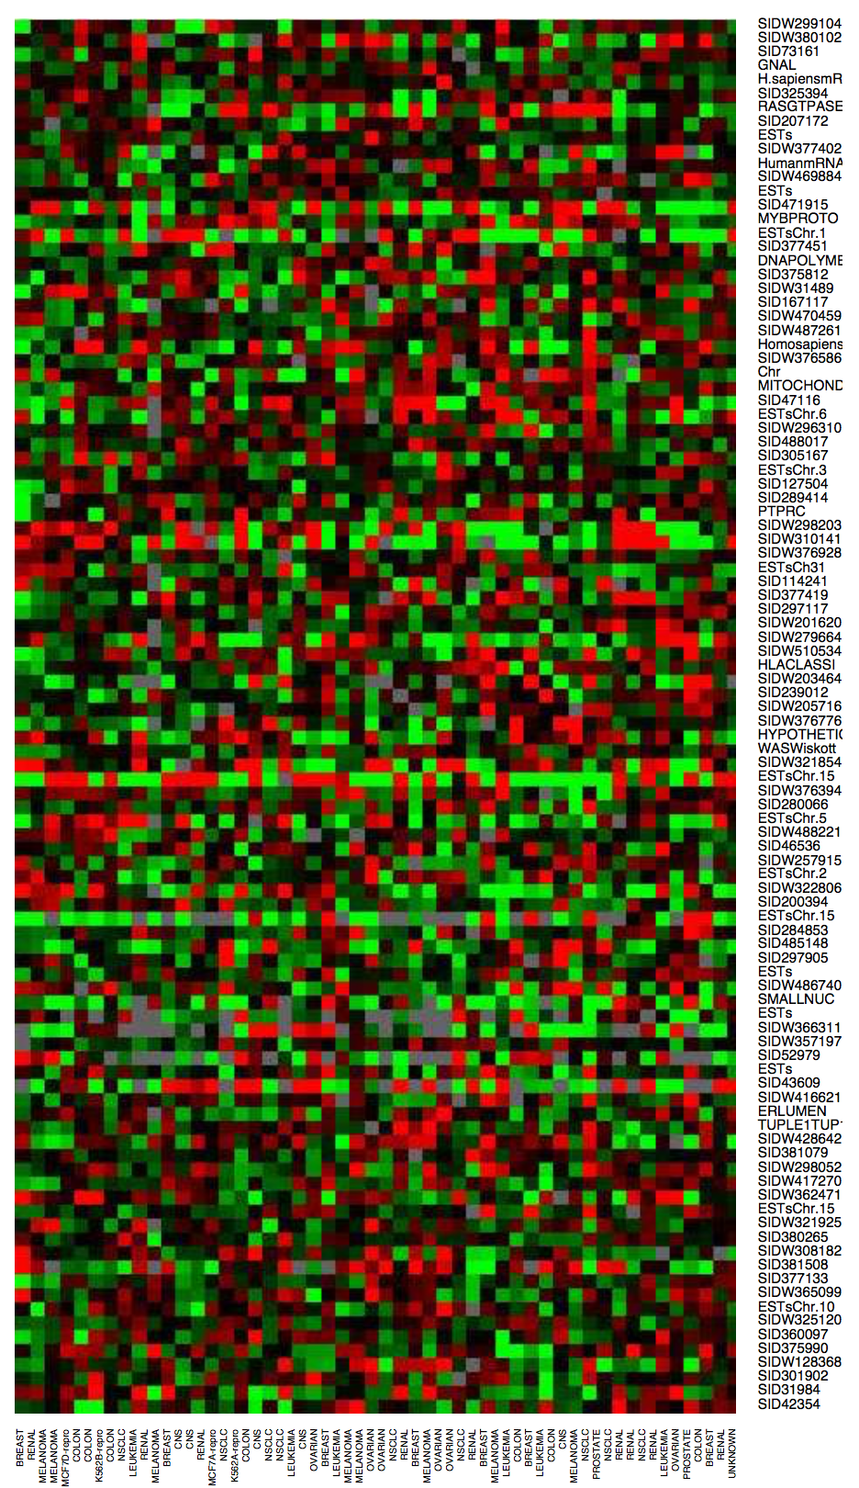
Data Science in practice
Which genes are overactive or underactive in cancer patients?

Slide 8
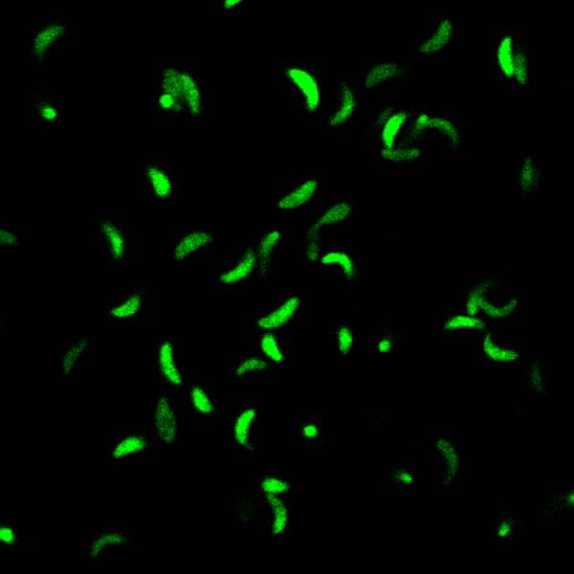
Data Science in practice
What factors determine the movement of the Toxoplasma gondii parasite?

Slide 9
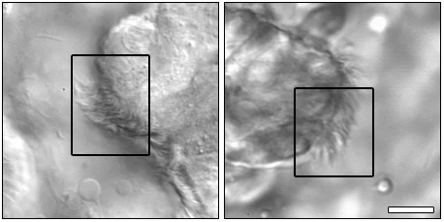
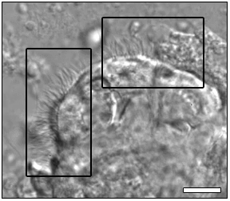
Data Science in practice
How is the motion of cilia associated with and indicative of specific pathologies?

Slide 10

Data Science in practice
What are the protein patterns of mitochondria under different conditions, and how do these changes take place?

Slide 11
What this course *is*
Picks up where 3360 Data Science I left off
A deeper dive into modeling and quantitative analysis methods
“What to do when you’ve already tried Option A”
Combination of theory and practice using latest data science tools and techniques

Slide 12
What this course is *not*
Introduction to probability and statistics
Should be able to derive Bayes’ Theorem from law of conditional probability, no sweat
Don’t need to prove the SVM dual, but should be aware of it and its function
Introduction to programming
No Python experience required, but are expected to pick it up FAST (i.e., you’ve programmed before, just not in Python)
Next week is a Python crash-course

Slide 13
What?
Course title: Data Science II
CSCI 4360 (for undergraduates)
CSCI 6360 (for graduates)
Course textbooks: none required
Lots of recommended books—check out the course website
Will continue to update with more references
Python: not required but strongly recommended
3.x (2.x is hitting EOL in a few weeks)
Details to come

Slide 14
Who?
Dr. Shannon Quinn (that’s me)
2008: B.S. in Computer Science from Georgia Tech (go Jackets!)
2010: M.S. in Computational Biology from Carnegie Mellon
2014: Ph.D. in Computational Biology from joint Carnegie Mellon-University of Pittsburgh Ph.D. Program in Computational Biology (CPCB)
Research areas
Biomedical imaging
Representation learning
Computer vision
Distributed computing
Biosurveillance
Data Science + Public Health

Slide 15
When and Where?
Lectures
Tuesdays and Thursdays: 2:00 – 3:15pm, Geography/Geology 200C
Mondays: 2:30 – 3:20pm, Chemistry 453
Office Hours
Boyd 638A
TBA (things are a bit crazy right now)
TA: TBA!
Office Hours: <TBA> (seeing a pattern? let’s train a classifier!)

Slide 16
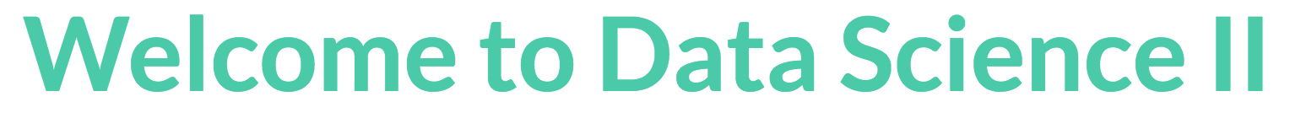
How?
Course website / syllabus: https://eds-uga.github.io/csci4360-fa19

Slide 17
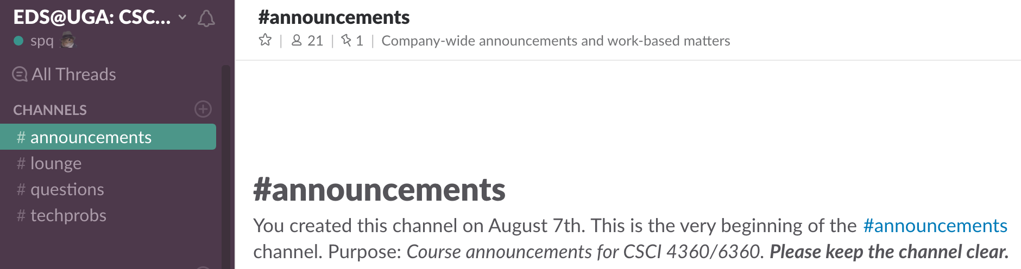
How?
Slack chat: https://eds-uga-csci4360.slack.com/

Slide 18
How?
Slack: post in #questions
Email: squinn@cs.uga.edu
I get tons of emails every day
Slack will not only likely get a faster response, but your fellow students could probably also answer even more quickly

Slide 19
Honesty at UGA
I’d like to think I don’t have to justify this
There’s an official UGA Honesty Policy https://ovpi.uga.edu/academic-honesty/academic-honesty-policy
I have automated code-checkers (thank you, data science)
It’s way easier than you think to spot copied code
The official policy in this class: Discuss ideas and concepts with your classmates (or anyone!). Write the code yourself (unless you’re on a team).

Slide 20
Attendance Policy
When I’m speaking—
Meh. You’re all adults
When anyone other than me is speaking—
Strict attendance requirement
Guest lecturers (will be at least 2 this semester), classmates (workshops, final projects)
If you need to miss class, that’s fine!
Don’t need to ask my permission, either
But you do need to tell me you won’t be attending, or couldn’t attend

Slide 21
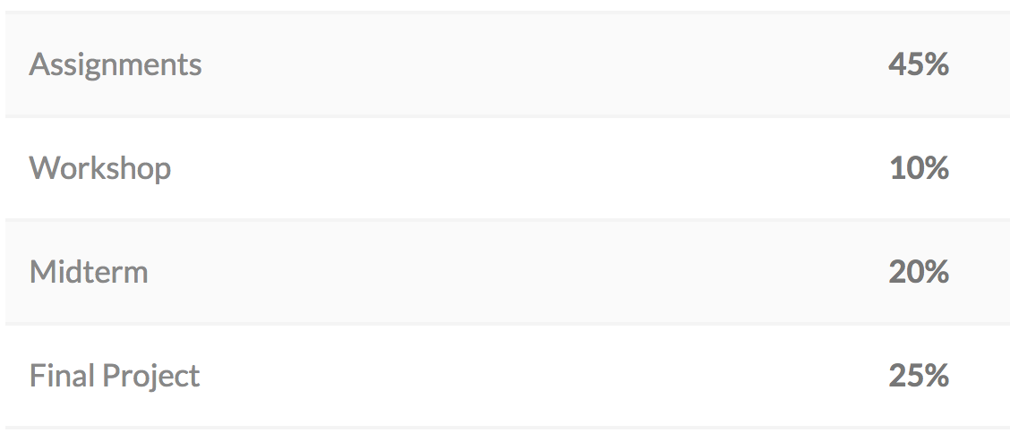
Grading Breakdown

Slide 22
Assignments
There will be 5
So yes, each is worth 9% of your grade
Each will be two weeks long
Released on a Tuesday morning, due two weeks later by 11:59:59pm
Will likely entail a written and a programming portion
Coding in Python
Writing in Word or LaTeX—nothing handwritten!
Details to come about how to submit the assignments

Slide 23
Workshops
Most Mondays, we’ll have a workshop
This is student-led and organized (you have to do one!)
The objective of each workshop is to demo a proof-of-concept for your student colleagues
This can be
implementing a topic we covered in class
demonstrating how to use a tool that would help with the topics we’re covering
some other neat course-related use-case
Recommended topics are on the course website!

Slide 24
Midterm exam
It’s an exam that happens near the mid-term (Oct 3), what more do you want?
(details will be released later)

Slide 25
Final Project
Teams (of 3-4 students, ideally) will work on a specific data science question
Three components:
The proposal, which outlines the team you’ll work with, the question you’ll address, and the methods + tools you’ll use to address it
The presentation, where you talk about how awesome your problem is and how you and your team killed it dead (or have almost done so)
The deliverables, consisting of 1) the complete code, and 2) a 6-10 page NIPS-style write-up of your project
More details to come!

Slide 26
”Assignment 0”
Email me with your preferred email for me to send you a Slack invite
Put together groups of 2-3 students and pick a date + topic for a workshop (see the course website for available dates)
Try to tie in with the lecture material surrounding that date, if possible
First [student-run] workshop is Monday, Aug 26!
Sign-up link will be posted in the Slack chat
Assignment 1 comes out Tuesday, so do this ASAP!

Slide 27
Next week
Workshop 0, on using the Anaconda distribution for installing and configuring your own Python environment! (far and away the easiest way to get up and running with Python)

Slide 28
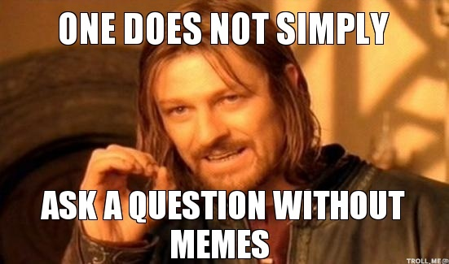
Questions?

